Slide 1


Alireza Ramezani
03/28/2024

Slide 2

Outline
Executive Summary
Introduction
Methodology
Results
Conclusion
Appendix

Slide 3
Executive Summary
Summary of methodologies
Our strategy involved utilizing both API integration and web scraping methods to gather data. After obtaining the data, we utilized various Python techniques to thoroughly process and clean it. We then used SQL queries to extract relevant information from the refined dataset. Early insights were obtained through systematic data visualization and trend analysis. To complete our analytical framework, we utilized supervised machine learning models to predict the success of landing events.
Summary of all results
By conducting thorough data analysis, we uncovered clear patterns and correlations among variables that directly impact the success of landing events. Using these insights, we built and trained a predictive model that showed significant ability to accurately predict the likelihood of a successful landing event. Importantly, the model achieved an impressive accuracy rate of 83%, highlighting its effectiveness in delivering dependable predictions within this field.

Slide 4
Introduction
SpaceX's dedication to reusable rockets has notably decreased the expenses associated with space travel by concentrating on retrieving the initial phase of the rocket. Preserving and reusing costly components from this phase is crucial for reducing costs directly. Evaluating the success rate of these retrieval events provides a significant metric for assessing efficiency and cost-effectiveness in SpaceX's innovative approach. This project focuses on predicting the success of the first phase retrieval event, providing predictive insights to improve decision-making within the space industry

Slide 5

Section 1

Slide 6
Methodology
Executive Summary
Data collection methodology:
Space X REST API
Web Scraping
Perform data wrangling
Dropping everything but Falcon 9 data
Missing Payload Mass values replaced by mean
Making outcomes into binary categorical data
Perform exploratory data analysis (EDA) using visualization and SQL
Scatter plots and Histograms
Maps and dashboards
Perform interactive visual analytics using Folium and Plotly Dash
Perform predictive analysis using classification models
Logistics Regression, SVM, Decision Trees, KNN

Slide 7
Data Collection
Data was first collected using SpaceX API (a RESTful API) by making a get request to theSpaceX API. This was done by first defining a series helper functions that would help in the use of the API to extract information using identification numbers in the launch data and then requesting rocket launch data from the SpaceX API url.
SpaceX launch data was requested and parsed using the GET request and then decoded the response content as aJson result which was then converted into a Pandas data frame.
performed web scraping to collect Falcon 9 historical launch records from Wikipedia page

Slide 8
Data Collection – SpaceX API
Define auxiliary function to parse the data
Retrieve data from the REST API using the method GET
Parse the data with the previously built auxiliary functions
Store the data in PANDAS DataFrame

Slide 9
Data Wrangling
Describe how data were processed
You need to present your data wrangling process using key phrases and flowcharts
Add the GitHub URL of your completed data wrangling related notebooks, as an external reference and peer-review purpose

Slide 10
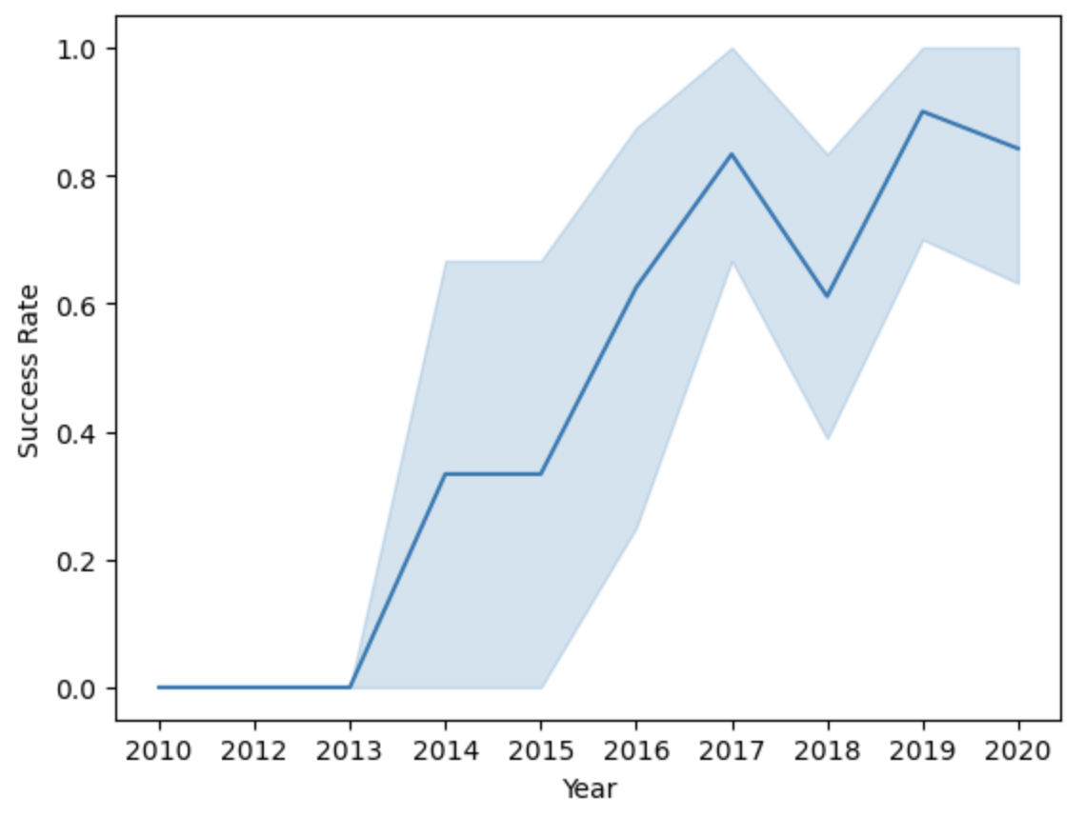
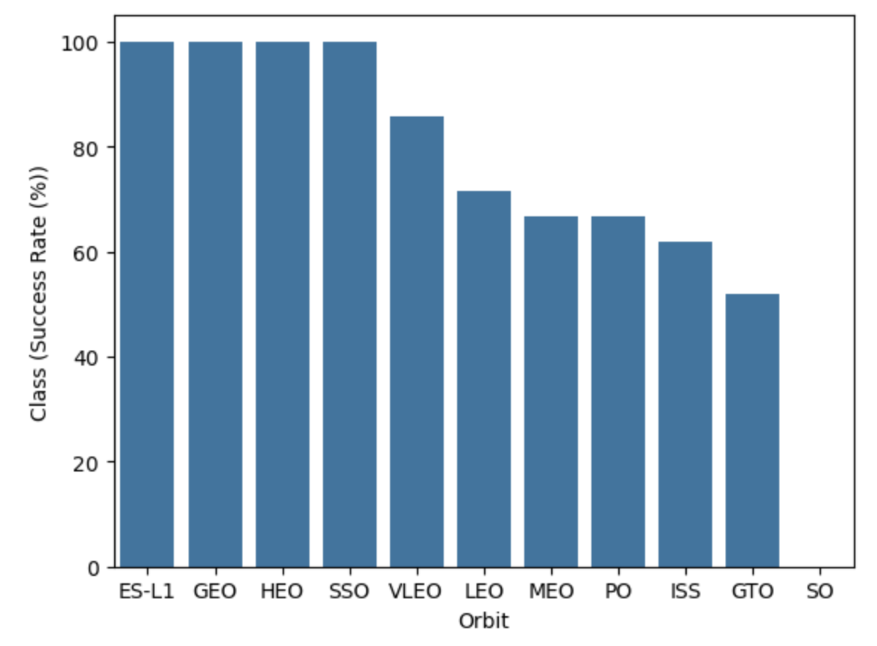
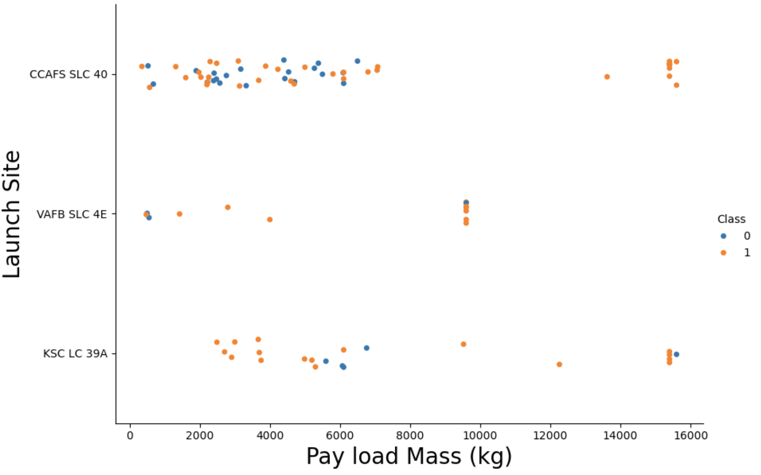
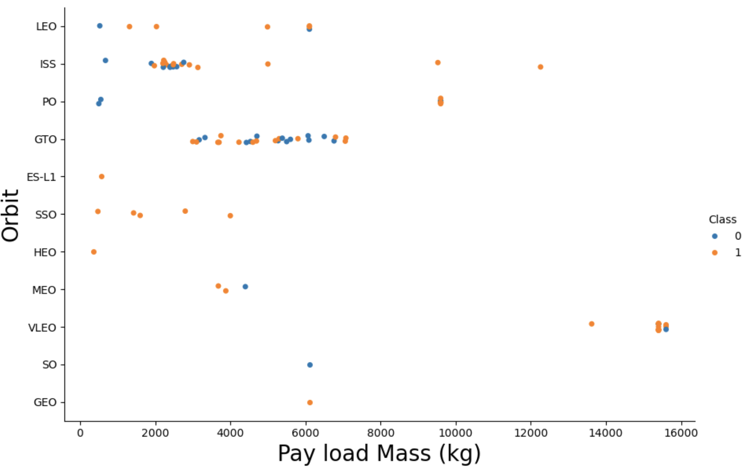
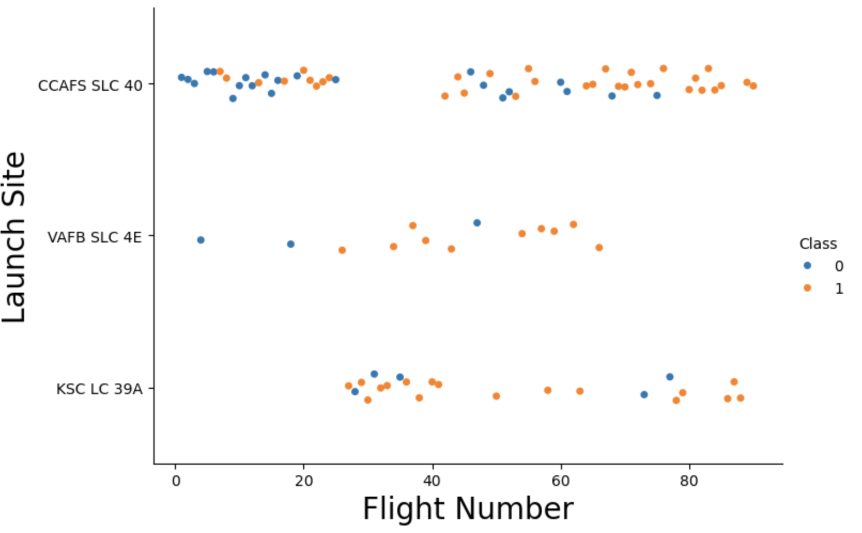
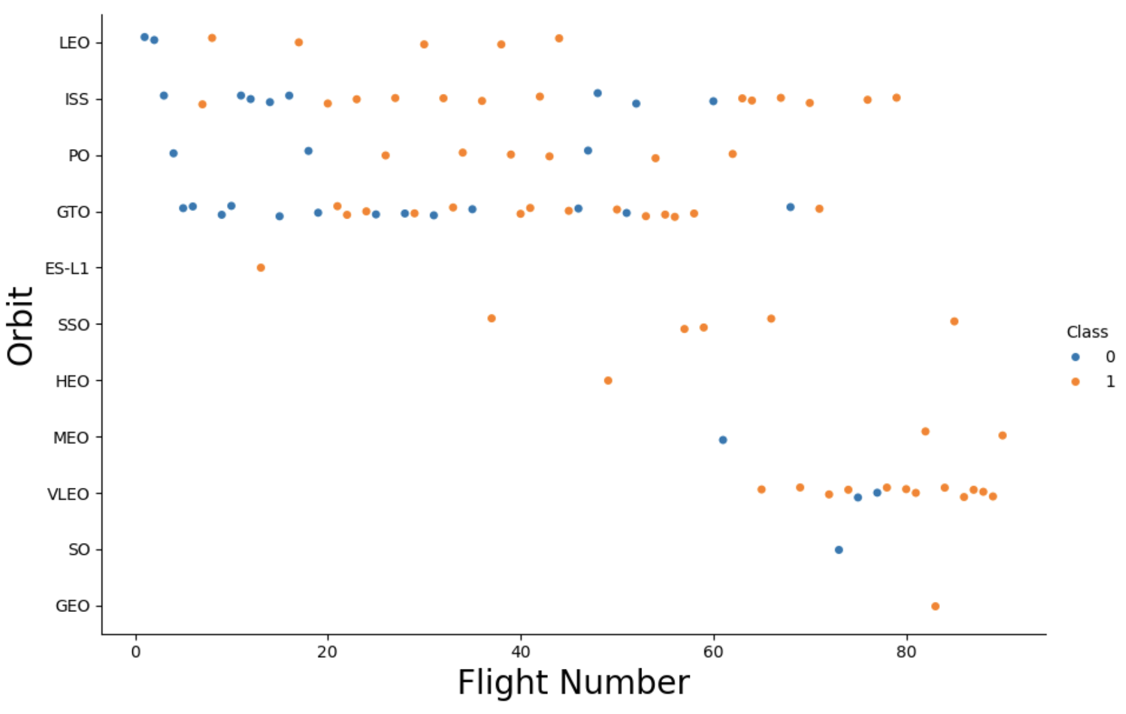
EDA with Data Visualization

Slide 11
EDA with SQL
Displaying the names of the launch sites.
Displaying 5 records where launch sites begin with the string ‘CCA’.
Displaying the total payload mass carried by booster launched by NASA (CRS).
Displaying the average payload mass carried by booster version F9 v1.1.
Listing the date when the first successful landing outcome in ground pad was achieved.
Listing the names of the boosters which have success in drone ship and have payload mass greater than 4000 but less than 6000.
Listing the total number of successful and failure mission outcomes.
Listing the names of the booster_versions which have carried the maximum payload mass.

Slide 12
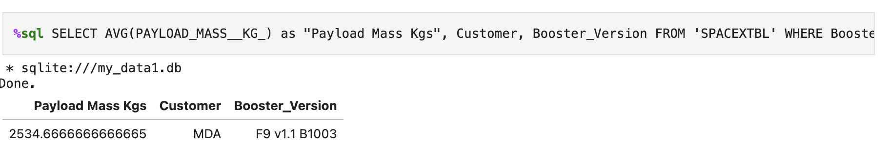
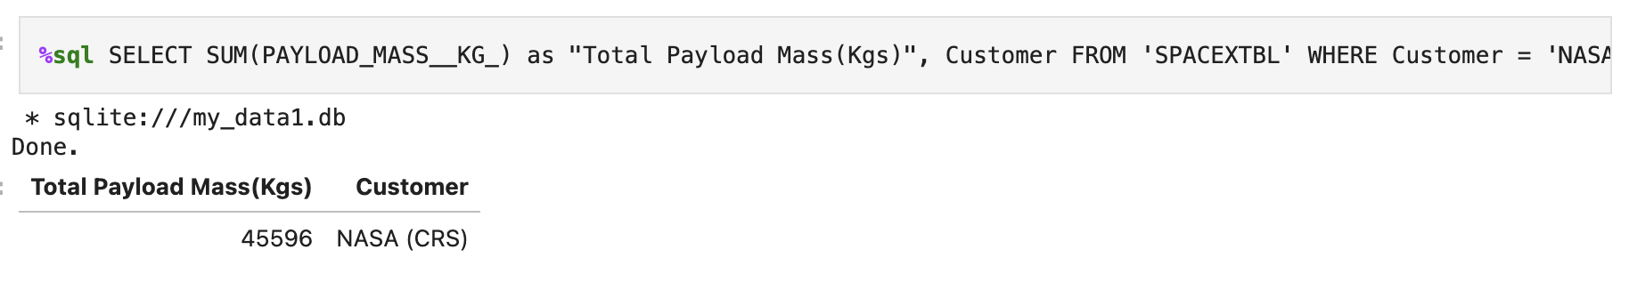
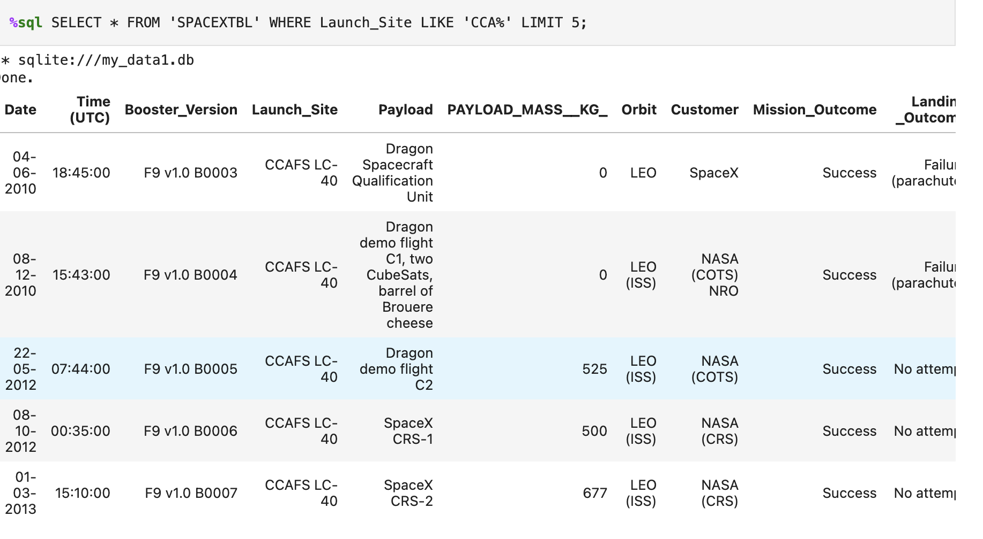
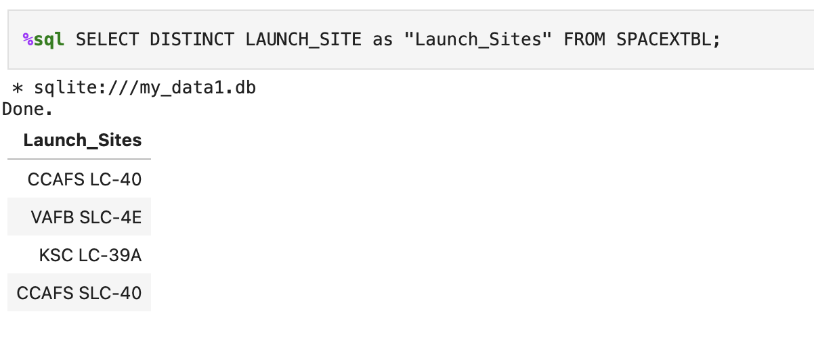

Slide 13
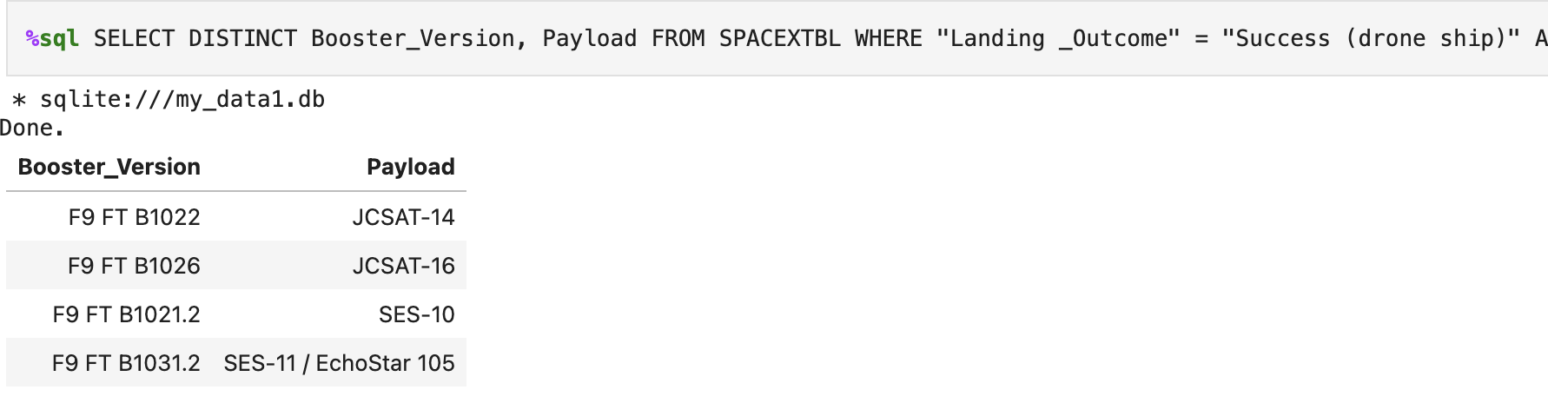
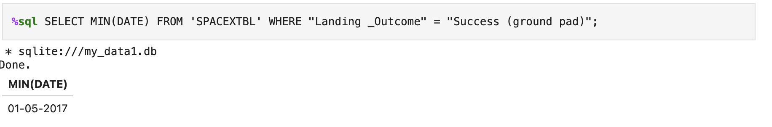
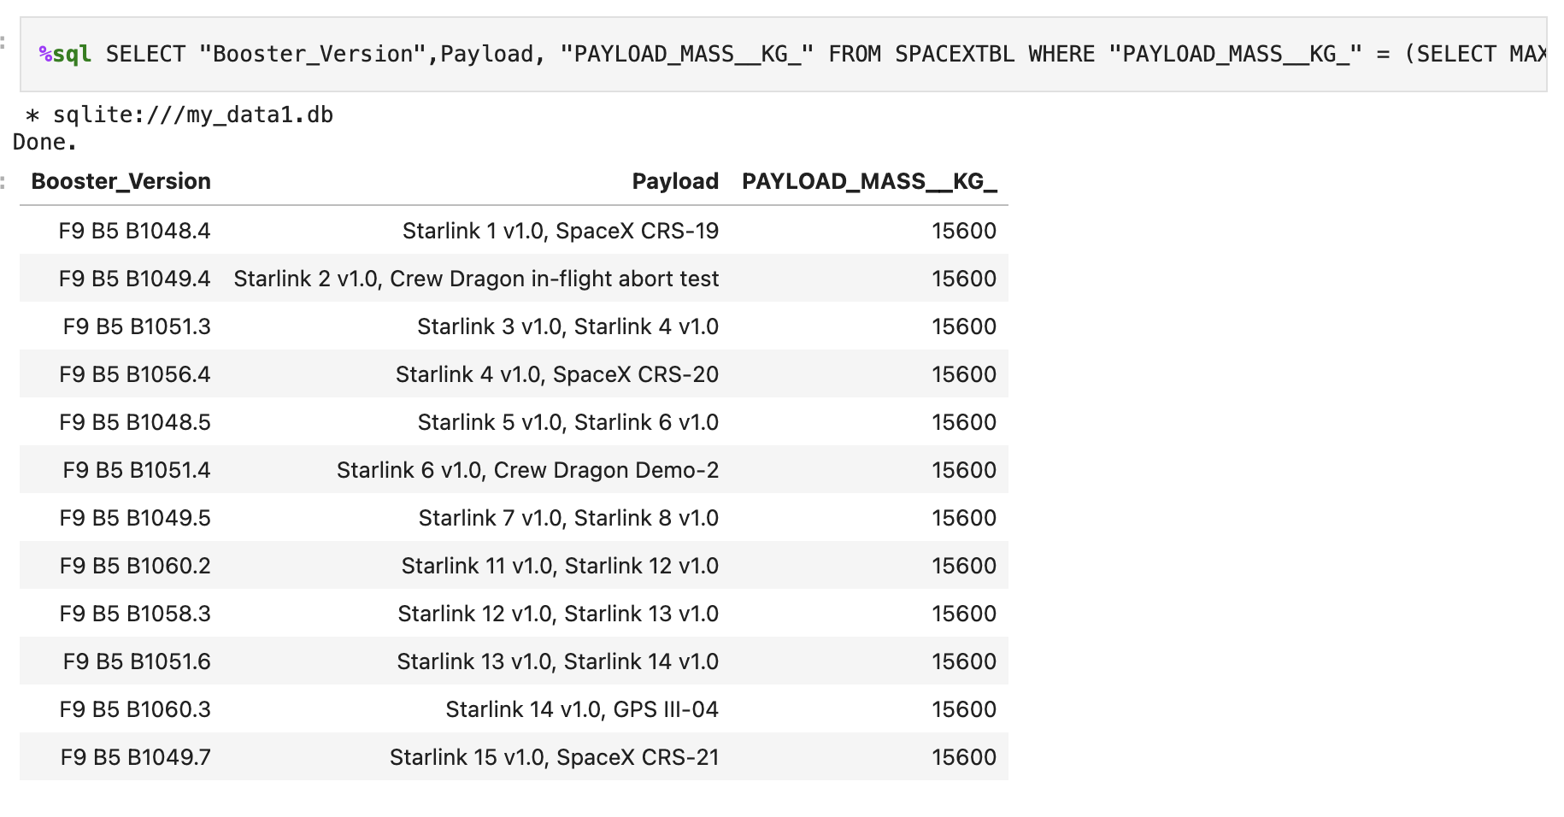
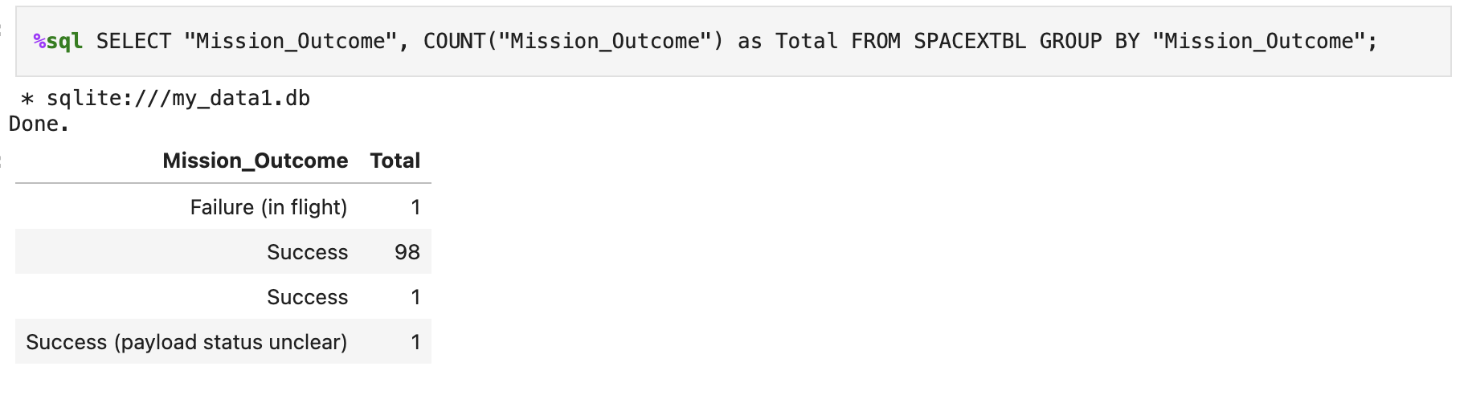

Slide 14
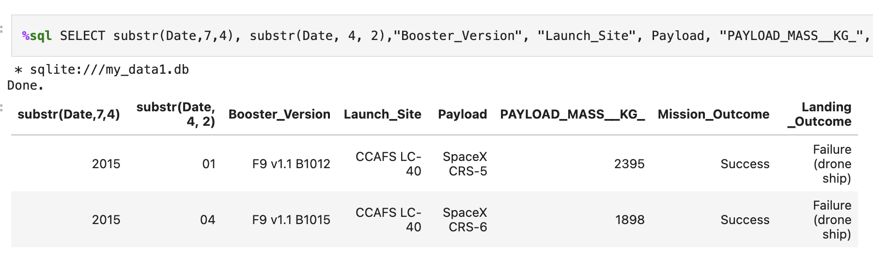
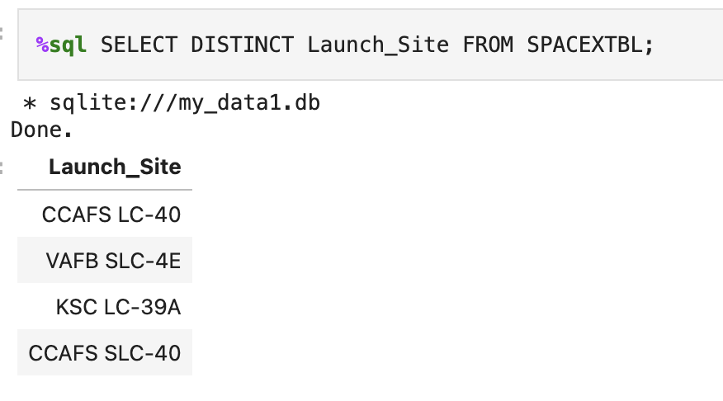
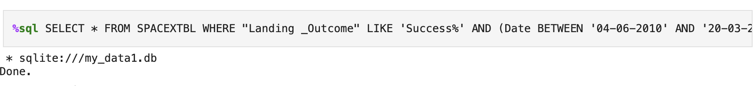

Slide 15
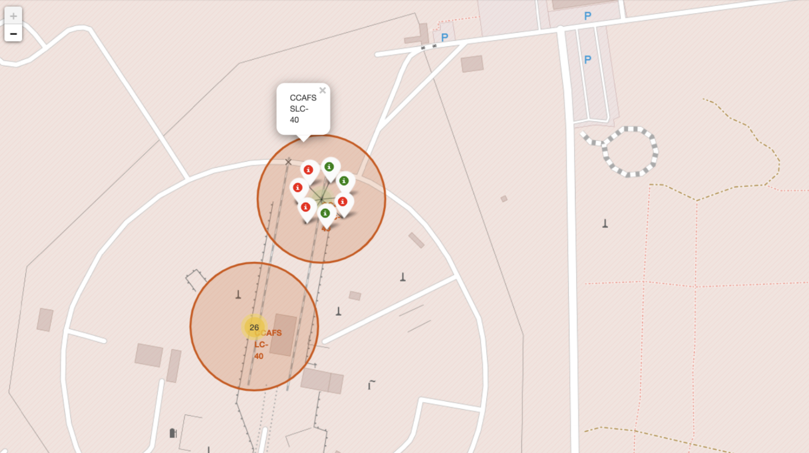
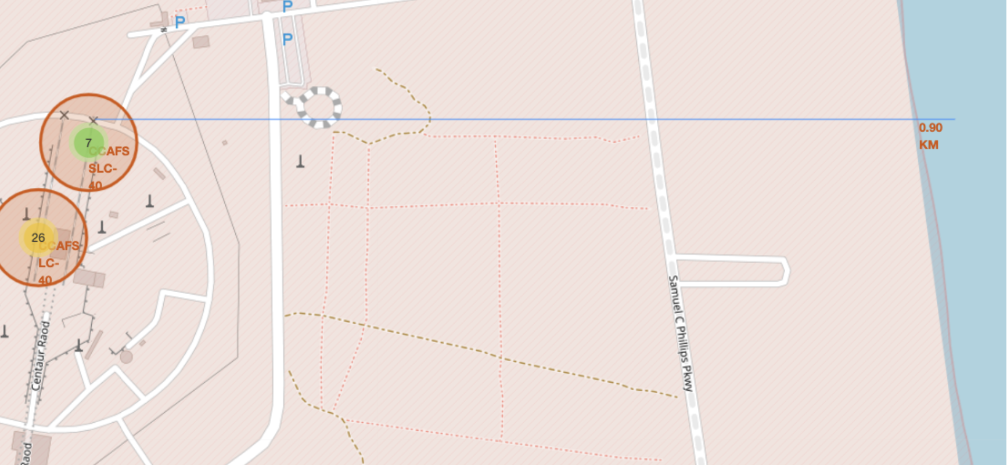
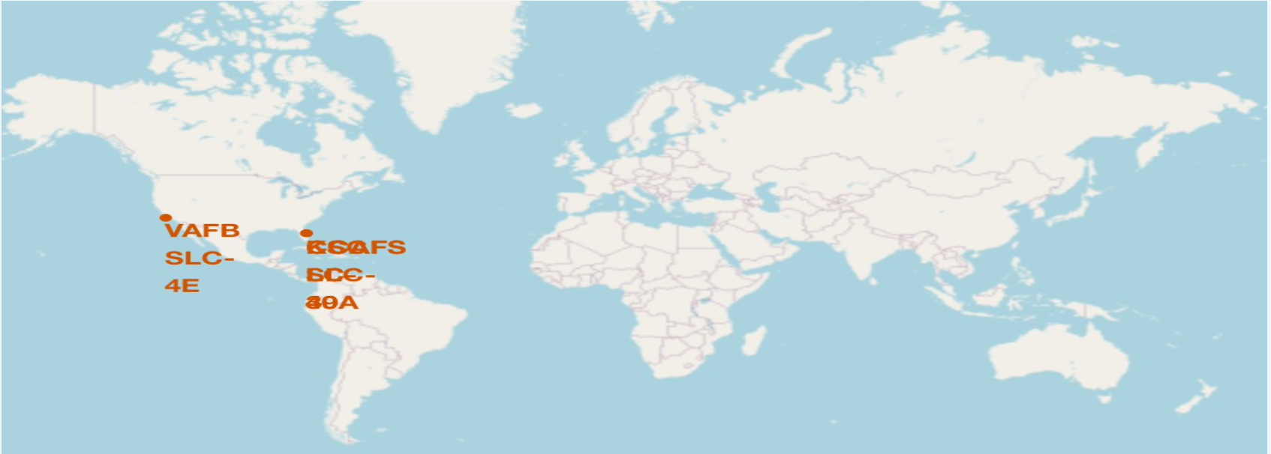
Build an Interactive Map with Folium

Slide 16
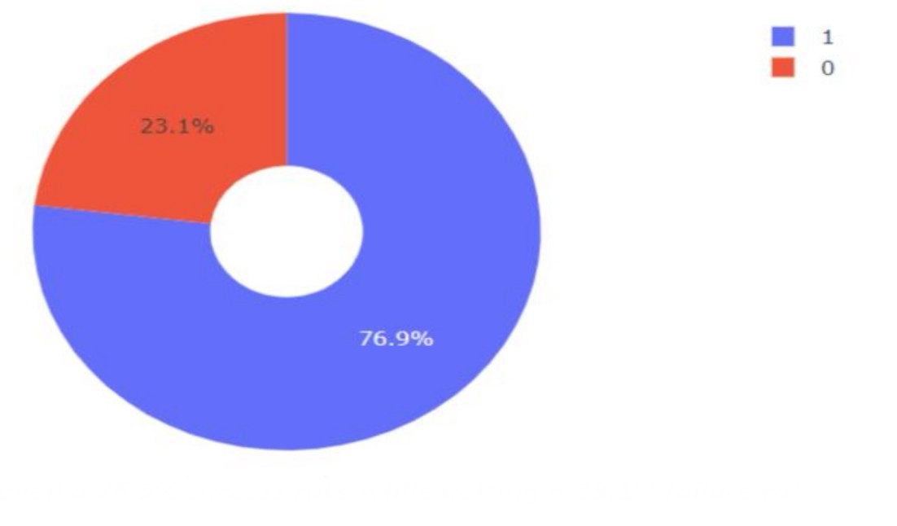
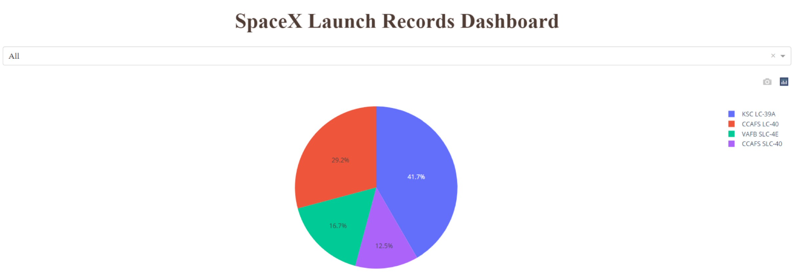
Build a Dashboard with Plotly Dash
We built an interactive dashboard with Plotly dash. We plotted pie charts showing the total launches by a certain sites.
We plotted scatter graph showing the relationship with Outcome and PayloadMass (Kg) for the different booster version.

Slide 17
Predictive Analysis (Classification)
We loaded the data using numpy and pandas, transformed the data, split our data into training and testing sets.
Tune different hyperparameters using GridSearchCV.
We used accuracy as the metric for our model, improved the model using feature engineering and algorithm tuning.

Slide 18
Results
Exploratory data analysis results
Interactive analytics demo in screenshots
Predictive analysis results

Slide 19

Section 5

Slide 20
Classification Accuracy
We loaded the data using numpy and pandas, transformed the data, split our data into training and testing sets.
Tune different hyperparameters using GridSearchCV.
We used accuracy as the metric for our model, improved the model using feature engineering and algorithm tuning.

Slide 21
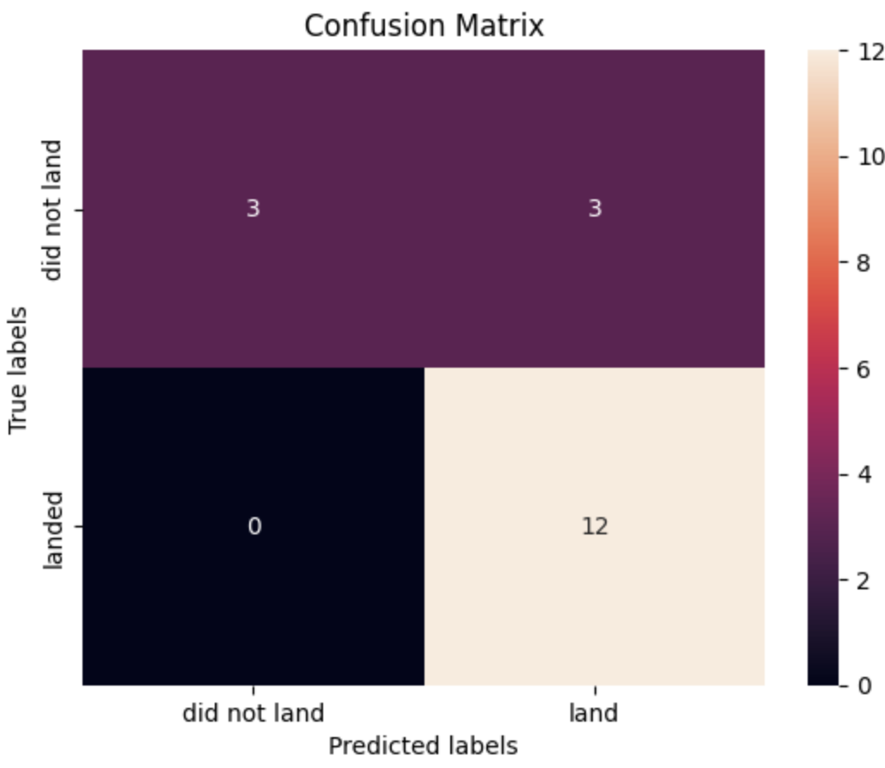
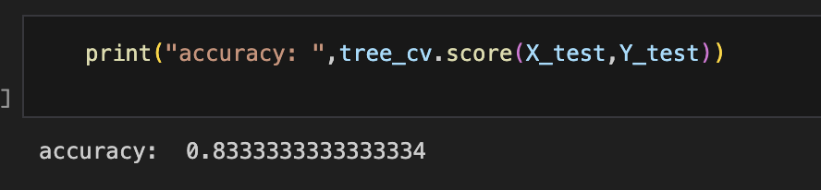
Confusion Matrix

Slide 22
Conclusions
The larger the flight amount at a launch site, the greater the success rate at a launch site.
Launch success rate started to increase in 2013 till 2020.

Slide 23


